Slide 1
Unit Test Basic
Part -3
“Tests are stories we tell the next generation of programmers on a project.” ― Roy Osherove

Slide 2
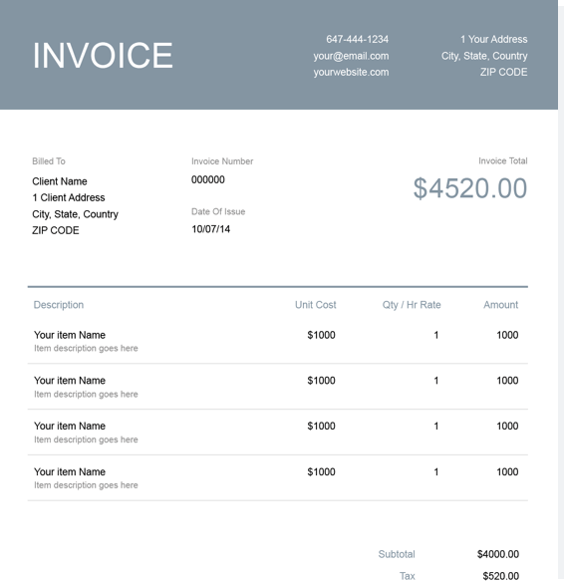
Mocking with Mockito
Create a Late Invoice Notifier which checks
for late invoices of customers and
sends them an email if an invoice is late.

Slide 3
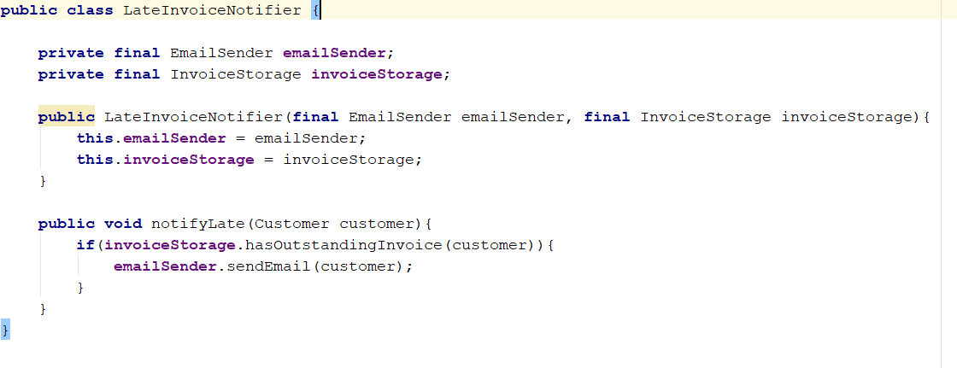

Slide 4
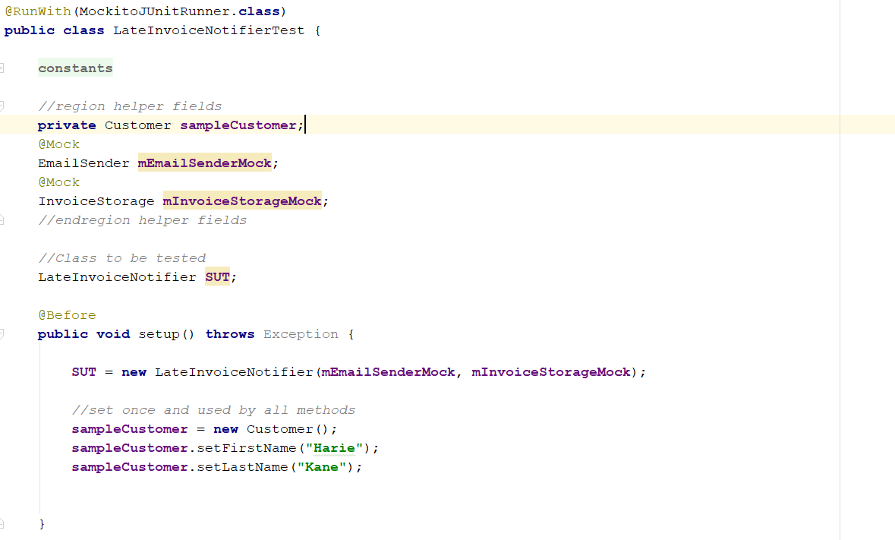

Slide 5
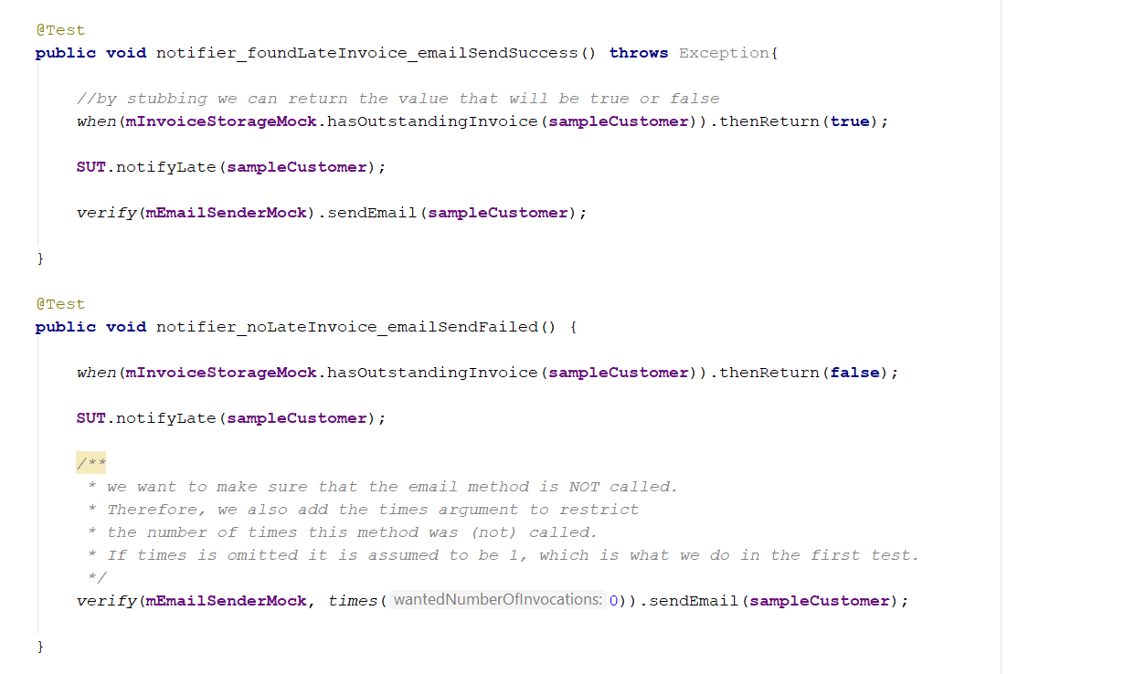

Slide 6
Verifying Arguments with Argument Captors
The previous example was relatively simple, we just verified whether a single method was called or not.
Sometimes we need more detail, and instead of looking only at the method call itself, we are also interested in the arguments.

Slide 7
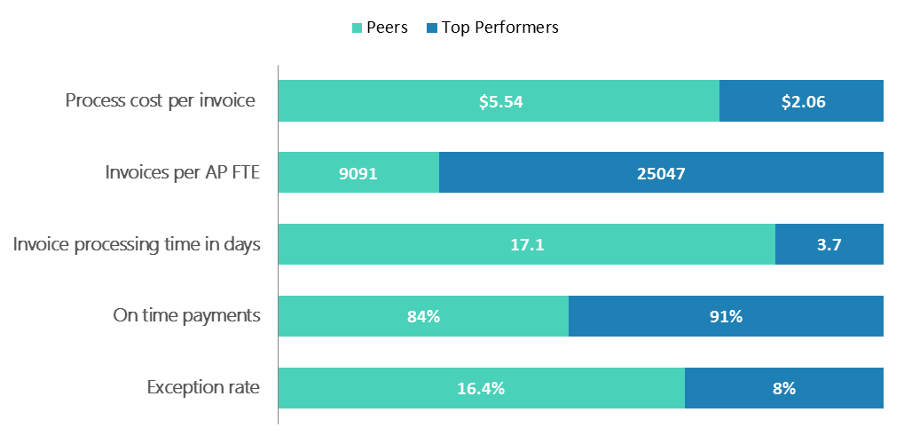
Example
let's assume that the analytics department wants more extensive metrics and asked you to implement an extra mechanism, where several important events for a customer are recorded and later analyzed.

Slide 8
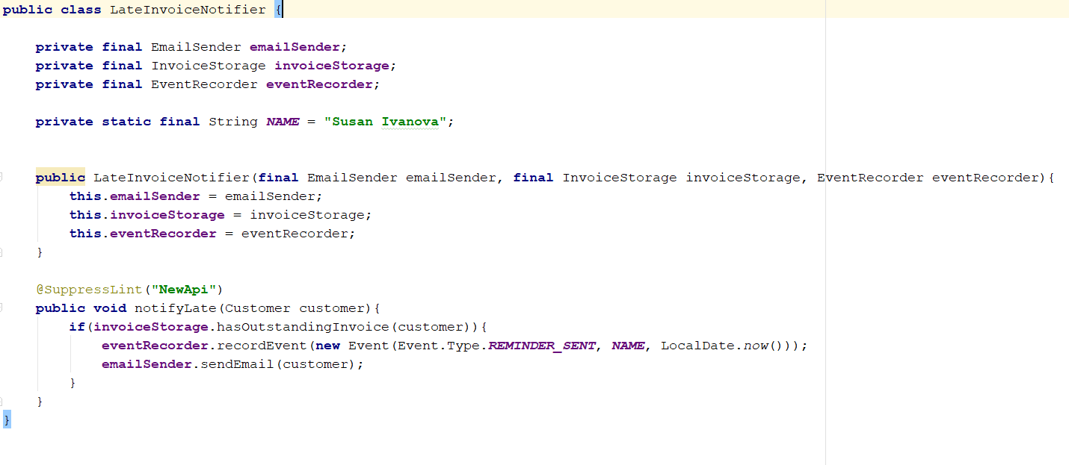

Slide 9
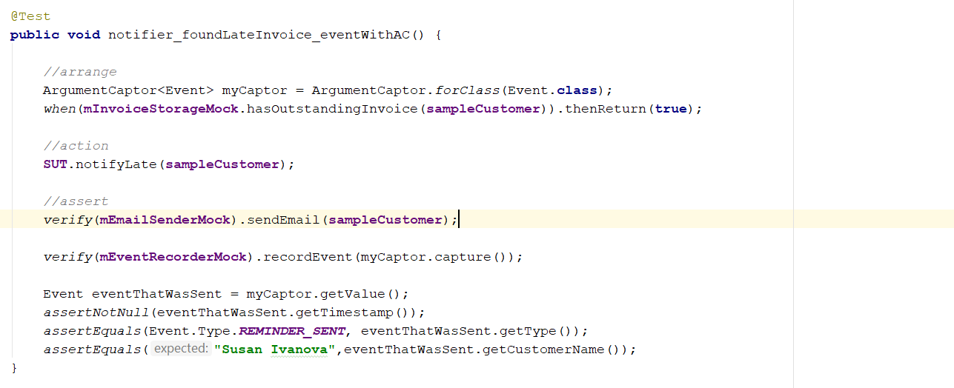

Slide 10


